Slide 1
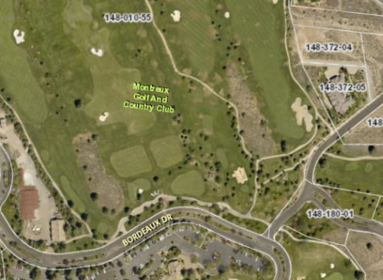
WADMIN19-0015 (Children’s Cabinet - Art of Childhood)
Washoe County Board of Adjustment
August 1, 2019

Slide 2
Request
This is a request for an administrative permit to allow for an outdoor community event business license, with conditions, for the Children’s Cabinet Art of Childhood, an outdoor community event to be held at the Montreux Golf and Country Club on August 23rd
The event qualifies as an “outdoor community event” under Washoe County Code (WCC) Section 25.272 and WCC Code 110.310.20 requires an Administrative Permit for an outdoor event

Slide 3
Background
The Art of Childhood event is the Children’s Cabinet annual fund raiser
It is estimated that 600 to 650 people will attend the event
The event is private and tickets are sold to attend the evening event that includes a live and silent auction along with cocktails and a three course meal

Slide 4
Event Details
The event is on August 23rd from 4 p.m. to 9 p.m.
Set-up begins on August 19th and the clean-up will be completed by August 24th
Tickets will be sold online or at the event and vary in price from $25 to $350
The food is prepared offsite and served by catering staff under two 40 x 120 foot tents on 68 tables
Parking will be available at the Montreux Club House and on the south side of De Chardin Lane
Also, a golf cart valet will be available for guests from the clubhouse parking lot to the event site
Montreux will inform the residents of the event and the parking plan

Slide 5
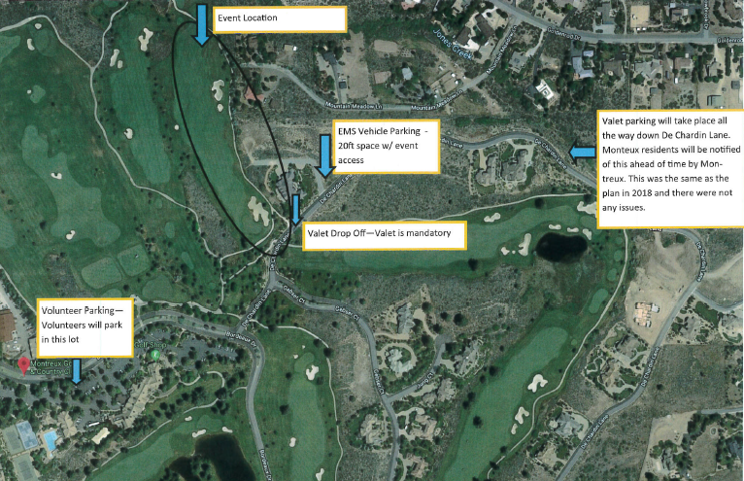

Slide 6
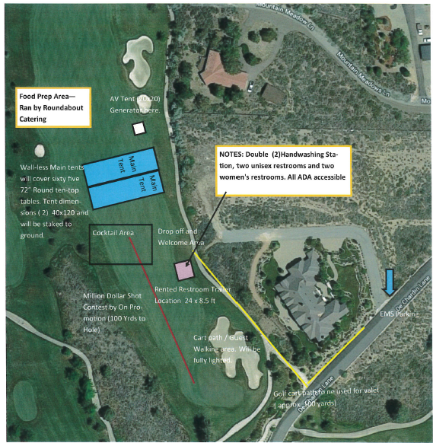

Slide 7
Public Notice & CAB
Public notice was sent to parcels within 500 feet from the site
The South Truckee Meadows/Washoe Valley CAB reviewed the application on July 11, 2019 and voted to approve the project

Slide 8
Reviewing Agencies
Various agencies reviewed the application, their comments are included in the staff report
Agencies with conditions, are included in the Conditions of Approval

Slide 9
Administrative Permit Findings
Consistency;
Improvements;
Site Suitability;
Issuance Not Detrimental
Staff is able to make the 4 required findings, as shown in the staff report on page 7 and recommends approval

Slide 10
Possible Motion
I move that, after giving reasoned consideration to the information contained in the staff report and information received during the public hearing, the Board of Adjustment approve, subject to the conditions contained as Exhibit A in the staff report, Administrative Permit Case Number WADMIN19-0015 for Children’s Cabinet, an administrative permit under WCC Section 110.310.20 and authorize the Director of the Planning and Development Division to issue an outdoor community event business license pursuant to WCC 25.272 when all pre-event conditions have been completed.

